Slide 1
Setting up a looking-glass server with OpenBSD & OpenBGPd
Adam Thompson
Consultant, Infrastructure Services
athompson@merlin.mb.ca
MUUG Meeting, 2019-Feb-11

Slide 2
VM creation
Running in VMware vSphere 6.x
Using HTML5 or Flash wizards to create the VM
Minimal resources required

Slide 3
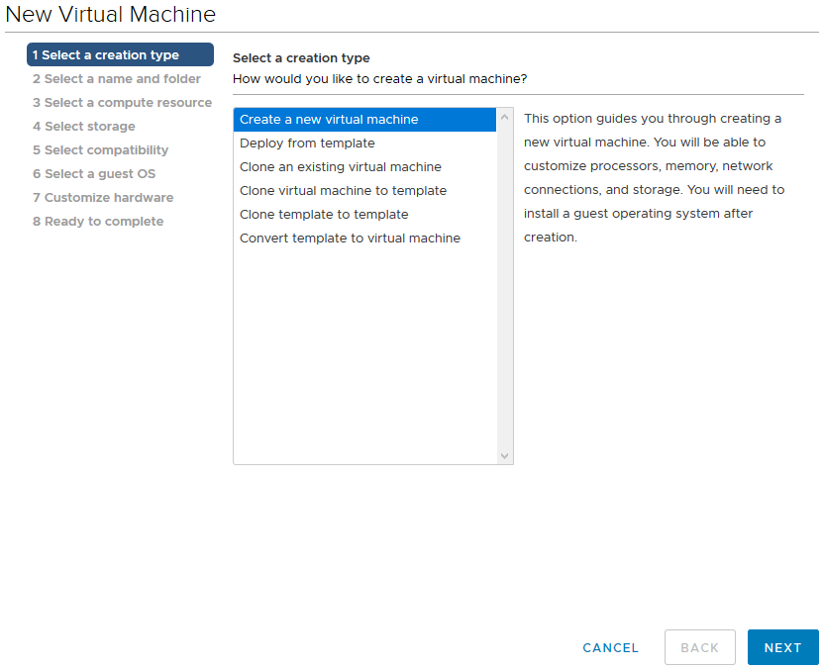

Slide 4
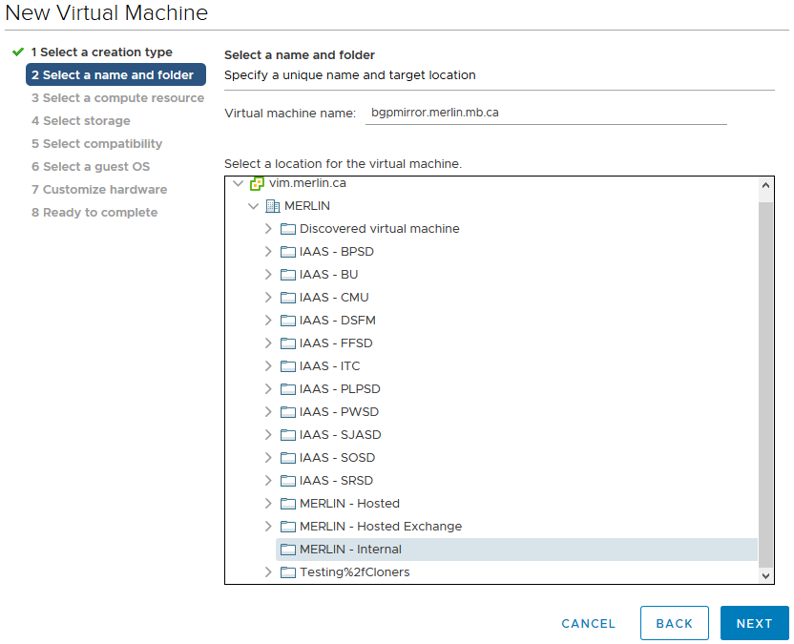

Slide 5
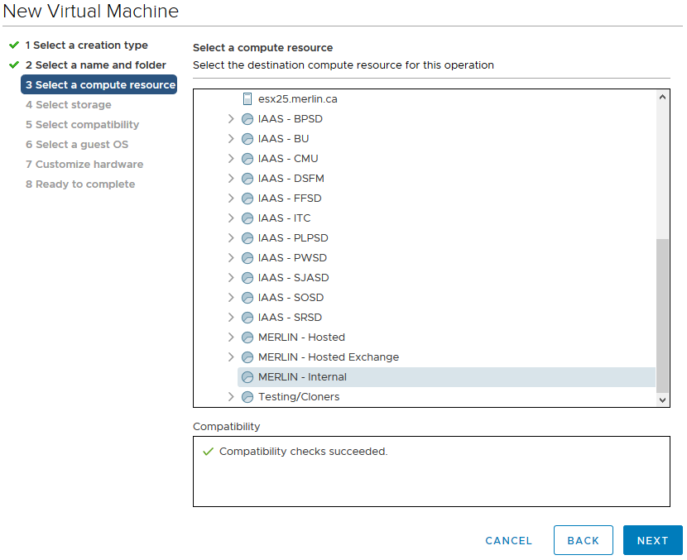

Slide 6
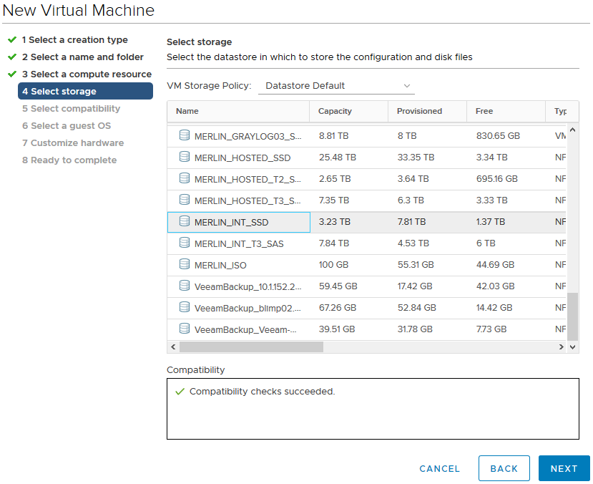

Slide 7
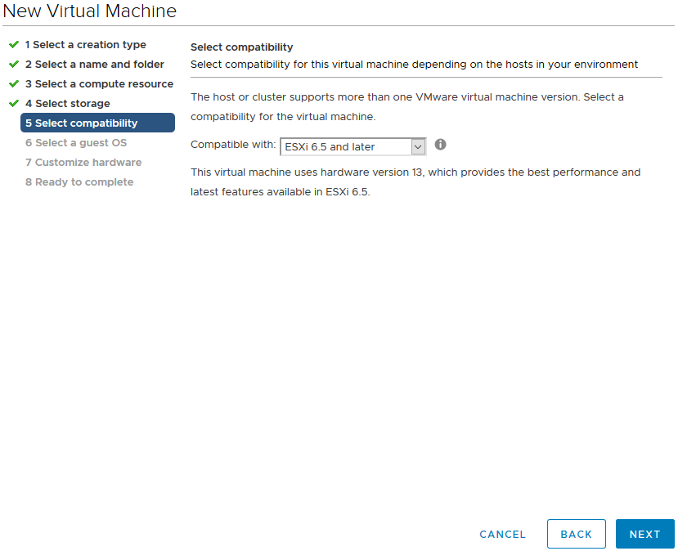

Slide 8
Note:
VMware does not specifically support OpenBSD, so we pick something close – 64-bit FreeBSD, in this case. This affects a number of compatibility options in the VM in subtle ways.

Slide 9
Here we have to make some changes:
HDD from SCSI0:0 to IDE0:0
delete the SCSI controller
NIC type to VMXNET2 (to avoid a bug with VMXNET3)
pick the correct VLAN
CDROM to IDE1:0
attach the OpenBSD-netinstall64.iso image
Video card to Auto-detect
(on VM Options tab) force BIOS Setup

Slide 10
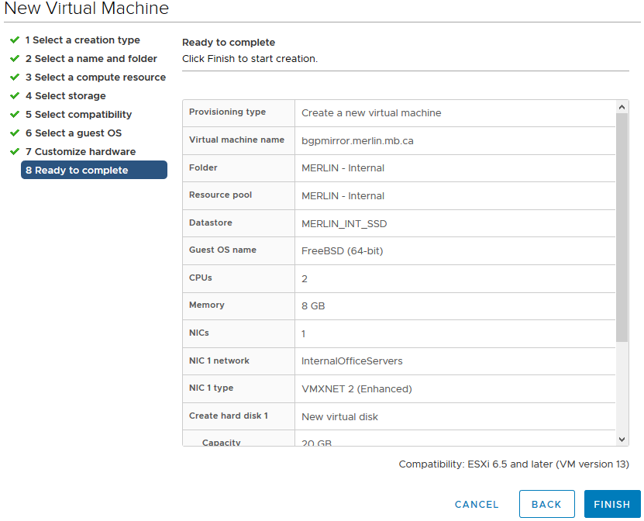

Slide 11
Power on the VM
BIOS setup screen will appear automatically this one time, because the checkbox in “VM Options” is a one-shot setting.
Change anything you need to in the BIOS
Typically boot order

Slide 12
OpenBSD Boot screen
…will automatically continue after 5sec if no key is pressed

Slide 13
Installation steps
Choose “I” for install
Keep the default keyboard layout
provide the short (unqualified) hostname
choose the vic(4) device (it’s the default)
enter an IPv4 address with netmask
enter an IPv6 address with netmask
enter for “done”
enter the IPv4 gateway
enter the domain name
enter the DNS nameservers
enter the root password
add a regular user (not shown)
provide full name for user

Slide 14
Installation steps (cont’d)
enter the password for that user
decide whether root can login via SSH or not (hint: do not pick “yes”)
select the correct timezone
pick whole disk
select custom layout
Default partition scheme is OK for some purposes, but partly obsolete in a VM where disks can be expanded.
Default partition scheme still offers some nice features, make sure you understand why it exists before discarding it.

Slide 15
Installation steps (cont’d)
add an “a” slice, filling the whole disk, mounted at “/”
no swap!
shouldn’t need it on this server

Slide 16
Installation steps (cont’d)
quit the partition editor
wait for formatting to finish
select “http”
skip the proxy
unless you need one, in which case my condolences
provide the server name
“muug.ca”
accept the default path
your MUUG mirror managers know their stuff ☺
press Enter again to confirm the defaults

Slide 17
Installation steps (cont’d)
wait for installation to complete
reboot

Slide 18
OS Configuration
Login as root on the console
or SSH in as the user you created, and use “su -” to become root
run syspatch(8) to update the kernel
reboot immediately

Slide 19
OS Configuration
edit /etc/ntpd.conf to disable the sometimes-buggy VMware time “sensor”
add local timeservers instead

Slide 20
OS Configuration
edit or create /etc/rc.conf.local to change default start/stop options
like using “sysconfig” in RHEL

Slide 21
OS Configuration
Copy example configuration files

Slide 22
OS Configuration
Add vim before using vi(1) drives me crazy

Slide 23
HTTPD configuration
edit httpd to be HTTP-only (no TLS)
just enough for our Letsencrypt cert to get created

Slide 24
TLS Cert creation
Edit the acme-client.conf file to use our public hostname and the STAGING server

Slide 25
Letsencrypt cert creation
make sure the webserver is running
“rcctl start httpd”
run “acme-client -DA”
if everything is setup correctly, you wind up with an SSL cert
that you can’t use

Slide 26
Letsencrypt cert creation
edit /etc/acme-client.conf
switch to the production Letsencrypt server
re-run “acme-client -DA”
edit httpd.conf
use the SSL cert we just got
restart httpd(8)
“rcctl restart httpd”

Slide 27
Letsencrypt cert creation
add a cron entry to keep the cert up to date

Slide 28
bgplg(8) configuration
Per the bgplg(8) manpage
chmod some files
create some directories
copy some files

Slide 29
bgplg(8) configuration
still following the bgplg(8) manpage:
add some lines to httpd.conf(5)
reload httpd(8)

Slide 30
After much troubleshooting, remove the first (global) “fastcgi” directive in httpd.conf, and now things mostly work… oops.

Slide 31
bgpd.conf (1/2)

Slide 32
bgpd.conf (2/2)

Slide 33
bgpd configuration
use “bgpctl show” to confirm all your sessions are up and running

Slide 34
bgplg(8) configuration
lastly, edit the customization files:
/var/www/conf/bgplg.{css,head,foot}

Slide 35
It’s alive!

Slide 36
further httpd.conf customization
If you want to redirect any and all visitors to the looking glass, add these two stanzas to the bottom of your httpd.conf.
The first block allows browsers to retrieve the images (under /htdocs, because we’re already chrooted to /var/www by default) and then for every single other path, redirect to the CGI.

Slide 37
Done!
Any questions?

