Slide 1

Wireless Theory and Regulations
For unlicensed wireless networks
Presentation by Wyatt Zacharias
Except where otherwise noted this work is licensed under the Creative Commons Attribution-ShareAlike 4.0 International License. To view a copy of this license, visit http://creativecommons.org/licenses/by-sa/4.0/.

Slide 2
The Decibel
The Decibel, notation: dB is a logarithmic unit used to represent a ratio between two values, most commonly power or intensity.
In common usage the decibel is used to indicate intensity in reference to a set base unit. In wireless context, the base unit used is the milliwatt (mW).
In order to communicate what the reference unit is, a letter will be appended to dB. For milliwatts, the letter m is appended: dBm.

Slide 3
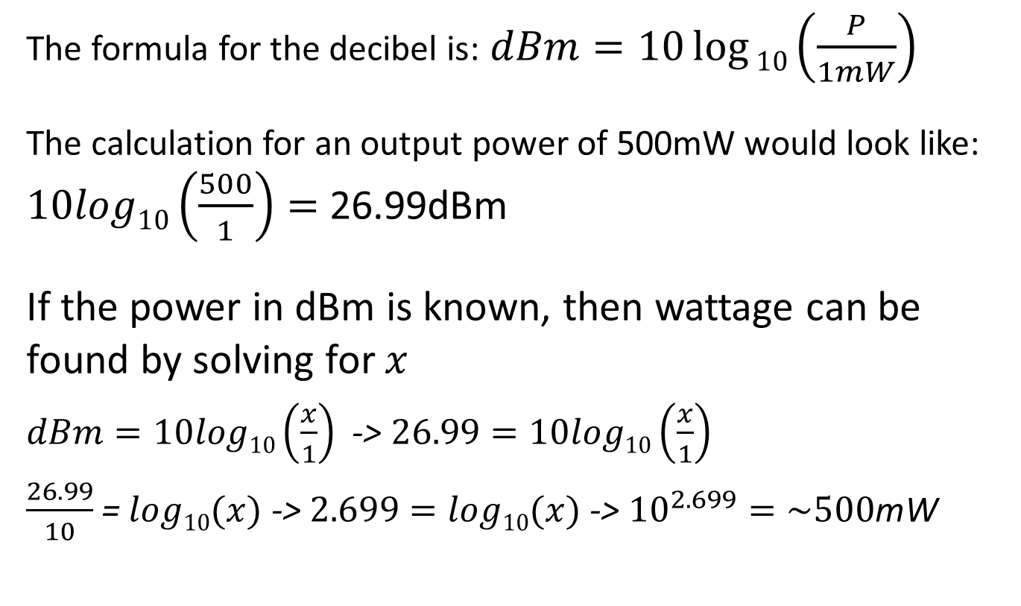
Decibel Calculation
The formula for the decibel is: $dBm=10\log{10\left(\frac{P}{1mW}\right)}$
The calculation for an output power of 500mW would look like: $10log10\left(\frac{500}{1}\right)=$26.99dBm
If the power in dBm is known, then wattage can be found by solving for $x$
$dBm=10log10\left(\frac{x}{1}\right)$ -> $26.99=10log10\left(\frac{x}{1}\right)$
$\frac{26.99}{10}$ = $log10(x)$ -> $2.699=log10(x)$ -> ${10}^{2.699}=\sim 500$mW

Slide 4
Antenna Gain
An antenna’s ability to convert input power to radiated power is described as gain.
Antenna gain is also measured in dB, with two common reference units used.
dBi – The antennas gain in reference to a theoretical radiator that emits equally in all directions
dBd – The antennas gain in reference to a dipole radiator.
1 dBd = 2.15dBi

Slide 5
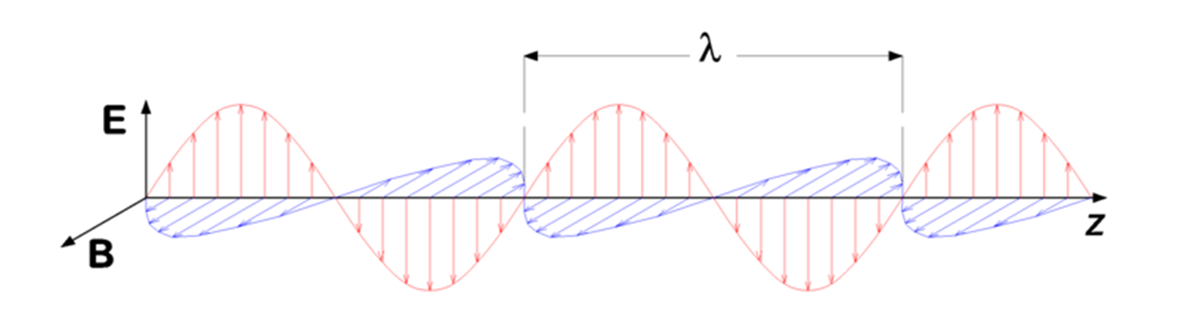

Polarization
The polarization of an antenna refers to the orientation of the electric field (E-Plane) in respect to the earth’s surface.
Because electromagnetic radiation is a transverse wave, the magnetic field (H-Plane) will be at 90° to the electric field.
For a dipole and other linear radiators, the E-Plane will be along the length of the radiator, thus an antenna running perpendicular to the earth’s surface has vertical polarization, while an antenna running parallel to the surface has horizontal polarization.
Image by P.wormer / CC-BY-SA 3.0 Unported

Slide 6
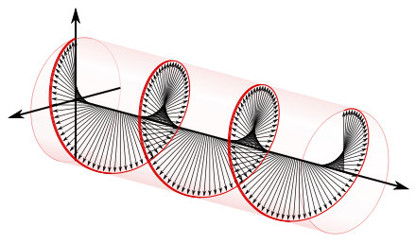

Other Polarization Patterns
In addition to linear polarization an antenna can be circularly or elliptically polarized. This means that the electric and magnetic fields are in a constant state of rotation, 90° apart.
Because of the losses of a linear polarization mismatch, circular polarization is most common with satellites where polarization of a linear antenna on the satellite could not be controlled.
Image Public Domain

Slide 7
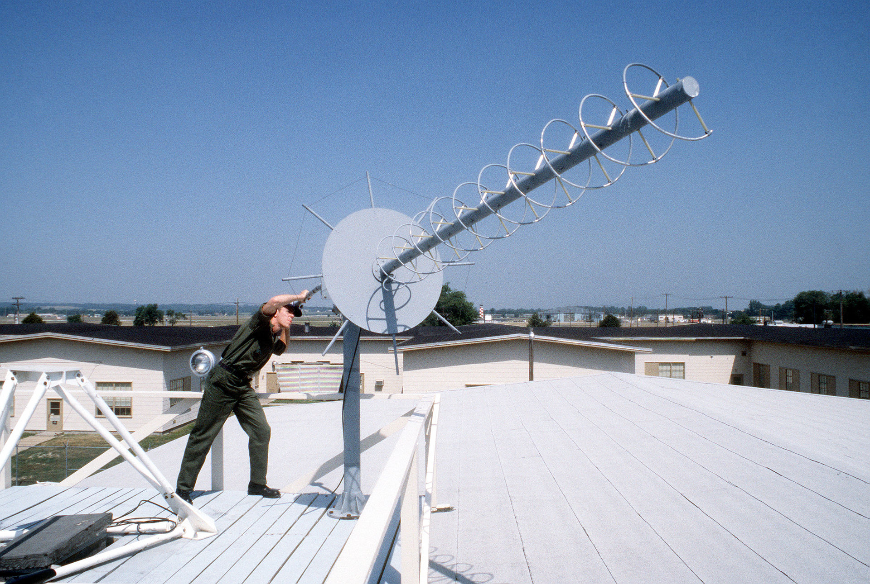
Image Public Domain

Slide 8
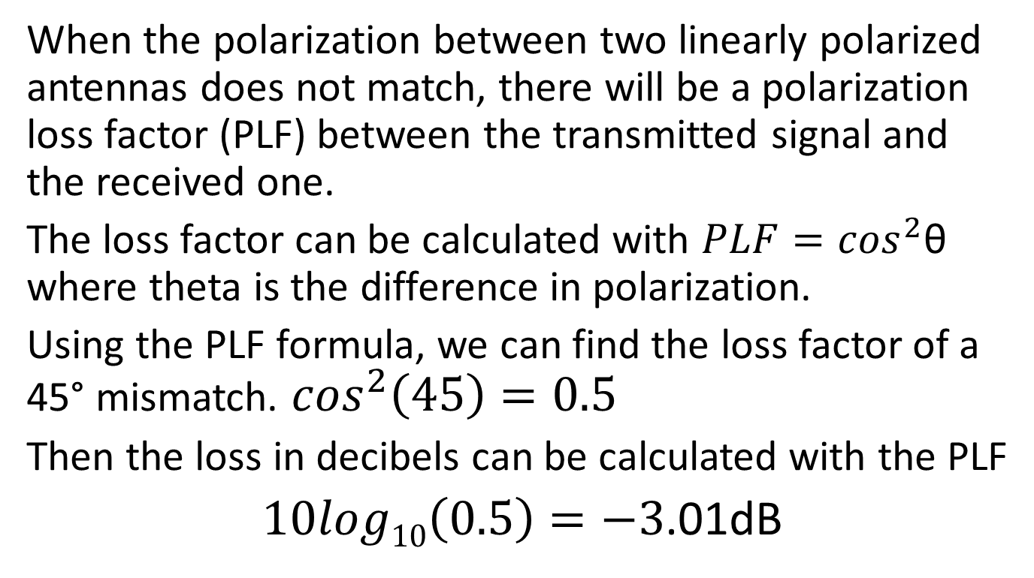
Polarization Losses
When the polarization between two linearly polarized antennas does not match, there will be a polarization loss factor (PLF) between the transmitted signal and the received one.
The loss factor can be calculated with $PLF=\cos^{2}$θ where theta is the difference in polarization.
Using the PLF formula, we can find the loss factor of a 45° mismatch. $\cos^{2}\left(45\right)=0.5$
Then the loss in decibels can be calculated with the PLF
$10log10\left(0.5\right)=−3$.01dB

Slide 9
Radiation Patterns
The radiation pattern of an antenna defines the strength of the radiation at different positions around the antenna.
Radiation patterns are typically expressed in two graphs, one depicting the E-Plane radiation, and the other depicting the H-Plane radiation.
Each graph depicts the radiation in a 360° radius with the antenna in the center.

Slide 10
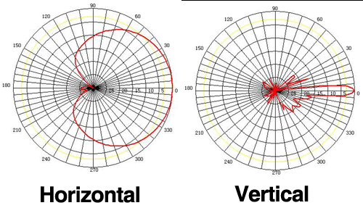
Image Public Domain

Slide 11
Transmission Line
Transmission line can be separated into two different types, balanced and unbalanced.
Unbalanced line, also known as coaxial cable, consists of a center conductor and an outer foil braid shield separated by an insulator.
Balanced line consists of two equally sized conductors connected in parallel with each other at a fixed distance apart.
In unbalanced lines the electromagnetic field is almost entirely contained within the shield, this allows coaxial cable to be run near power lines and other metal objects without interference.
In balanced lines the electromagnetic field is located between the two conductors. This makes the signal susceptible to interference from external objects, such as metal and other materials.

Slide 12
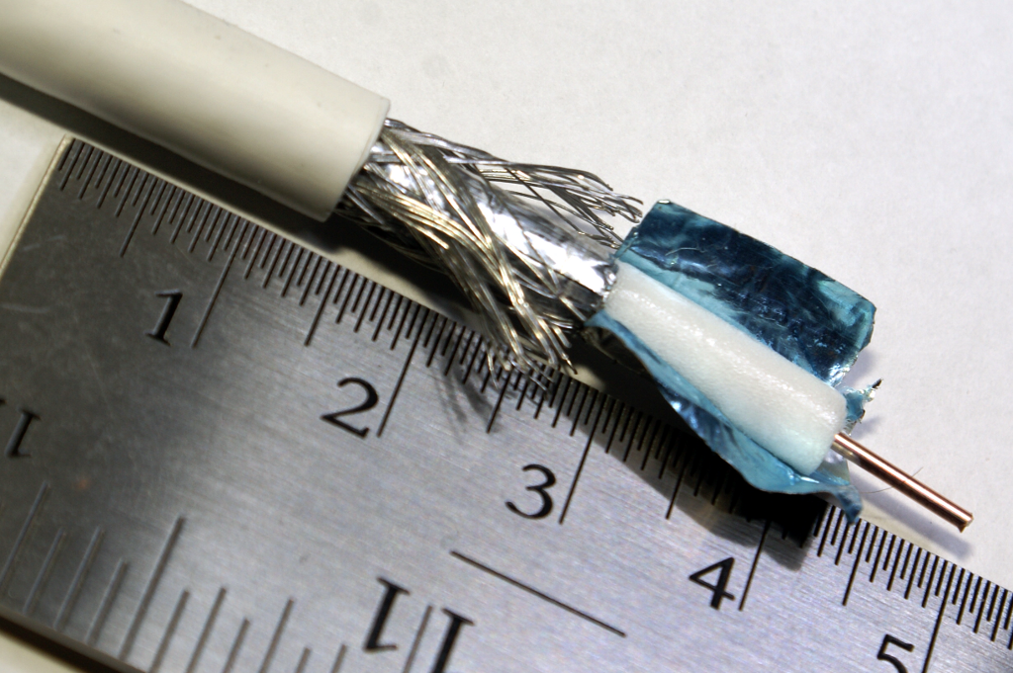
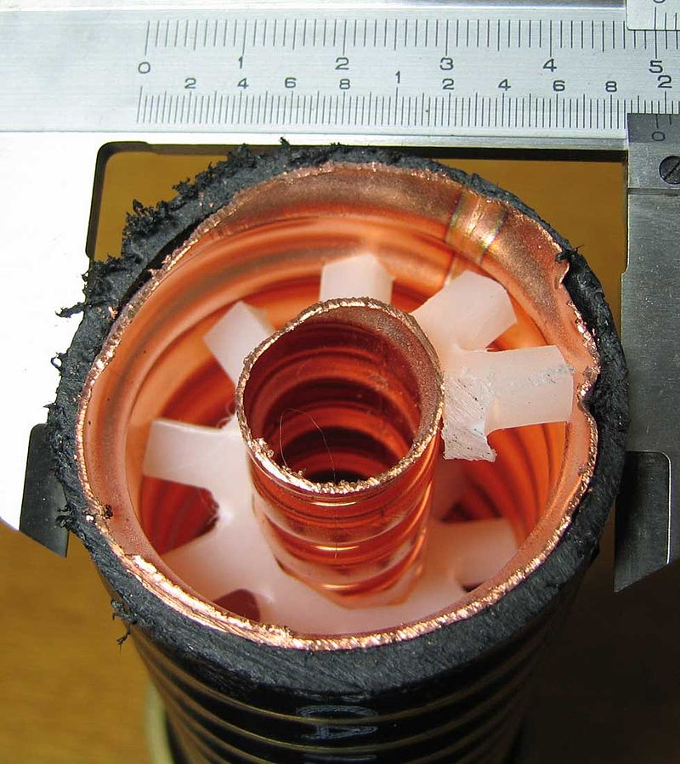
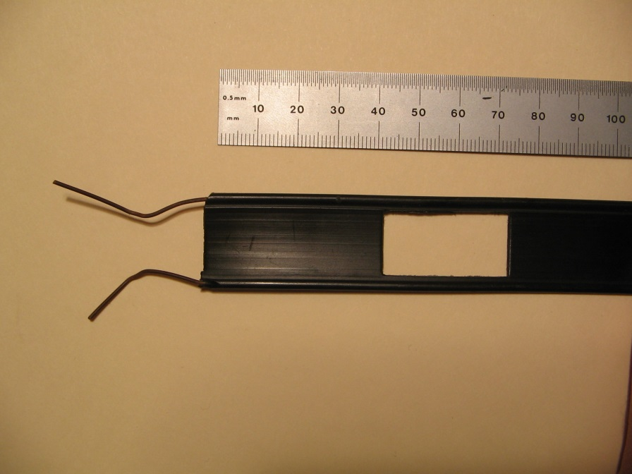
Photo by Apolkhanov / CC-BY-SA 3.0 Unported
Photo by Miikka Raninen / CC-BY-SA 3.0 Unported
Photo by Gerry Ashton / CC-BY-SA 3.0 Unported

Slide 13
Transmission Line Loss
Different cables offer different amounts of power handling and signal loss depending on application. Balanced line typically has good power handling and signal loss figures, however the susceptibility to physical interference and its high impedance make it harder to work with.
Coaxial line has the advantage that its impedance is almost always compatible, and it is does not suffer from physical interference. Coaxial line tends to have a higher signal loss however, this can be compensated for with higher quality cable.

Slide 14
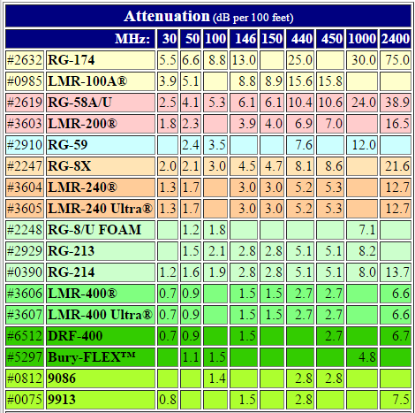
Typical Line Losses
As frequency increases so does transmission loss in the cable. Losses become very significant as frequency passes 1Ghz.
Table Copyright 2002-2015 universal-radio.com

Slide 15
Calculating ERP
Once all gains and losses are known the effective radiated power of the transmitter can be calculated. To do this, a sum of all gains and losses is taken, and then it can be converted to watts.
Lets calculate the ERP for a 500mW 2.4GHz transmitter with a 6dBi antenna connected with 20ft of LMR-400.

Slide 16
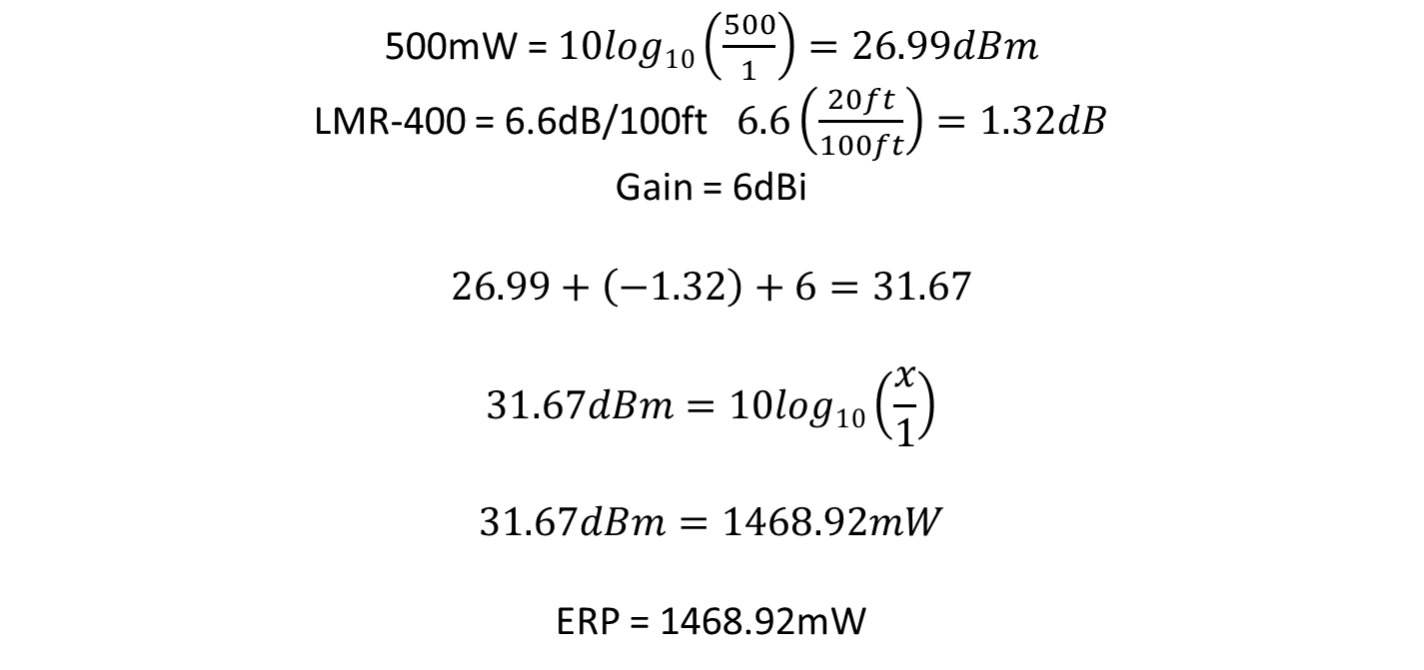
500mW = $10log10\left(\frac{500}{1}\right)=26.99dBm$
LMR-400 = 6.6dB/100ft $6.6\left(\frac{20ft}{100ft}\right)=1.32dB$
Gain = 6dBi
$$26.99+\left(−1.32\right)+6=31.67$$
$$31.67dBm=10log10\left(\frac{x}{1}\right)$$
$$31.67dBm=1468.92mW$$
ERP = 1468.92mW

Slide 17
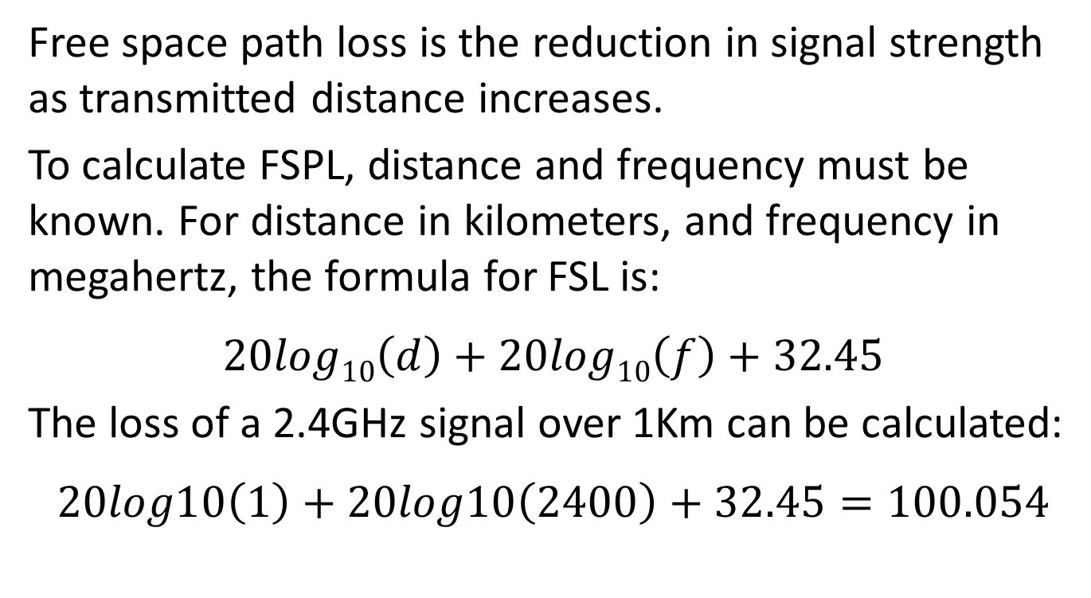
Free Space Path Loss
Free space path loss is the reduction in signal strength as transmitted distance increases.
To calculate FSPL, distance and frequency must be known. For distance in kilometers, and frequency in megahertz, the formula for FSL is:
$$20log10\left(d\right)+20log10\left(f\right)+32.45$$
The loss of a 2.4GHz signal over 1Km can be calculated:
$$20log10\left(1\right)+20log10\left(2400\right)+32.45=100.054$$

Slide 18
Fresnel Zones
A Fresnel zone is an elliptically shaped area stretching between a transmitter and a receiver.
In theory there are multiple Fresnel zones increasing in size around the longitudinal axis between transmitter and receiver. In practice the first Fresnel zone is the most important, and has the largest effect on signal degradation.
Objects in this area are capable of disrupting the transmission path of a signal, causing constructive or destructive interference.

Slide 19
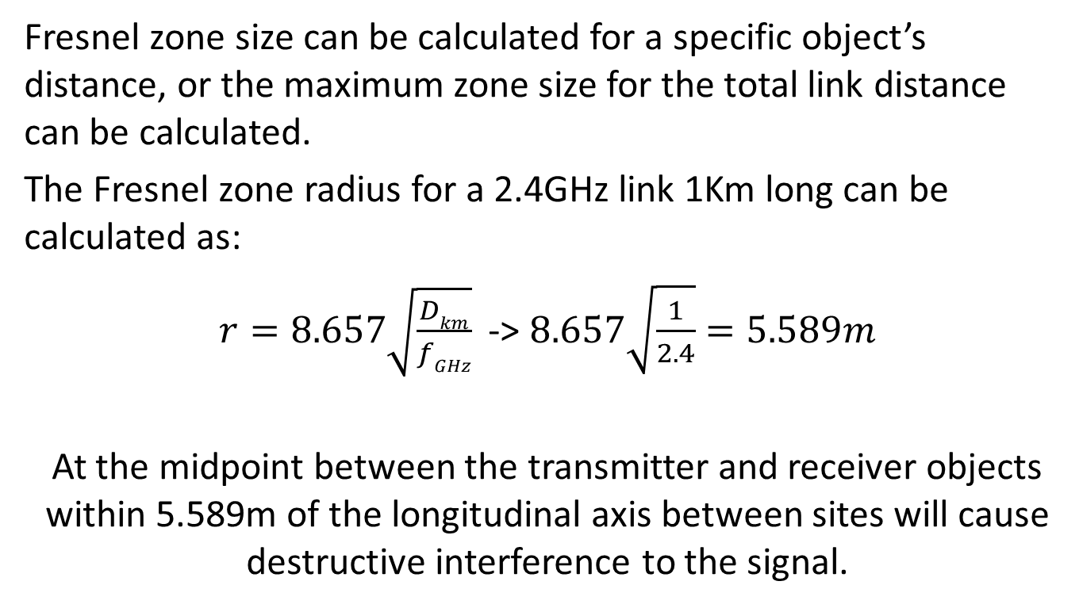
Fresnel Zone Calculations
Fresnel zone size can be calculated for a specific object’s distance, or the maximum zone size for the total link distance can be calculated.
The Fresnel zone radius for a 2.4GHz link 1Km long can be calculated as:
$r=8.657\sqrt{\frac{Dkm}{fGHz}}$ -> $8.657\sqrt{\frac{1}{2.4}}=5.589m$
At the midpoint between the transmitter and receiver objects within 5.589m of the longitudinal axis between sites will cause destructive interference to the signal.

Slide 20
Point to Point Links
Calculating the overall feasibility of a point to point link is similar calculating ERP, all gains and losses from the transmitter are summed. Additionally the gains and losses of the receiving station, along with the receiver sensitivity and the Fresnel zone between the sites will be taken into account.
Lets calculate a 2Km 2.4GHz link hoping to achieve 150Mbit/s 802.11n with a 600mW transmitter with a 15dBi antenna, and a receiver with 10dBi antenna and a -75dBm sensitivity to achieve 150Mbit/s each with 20ft of LMR-400 on each antenna.

Slide 21
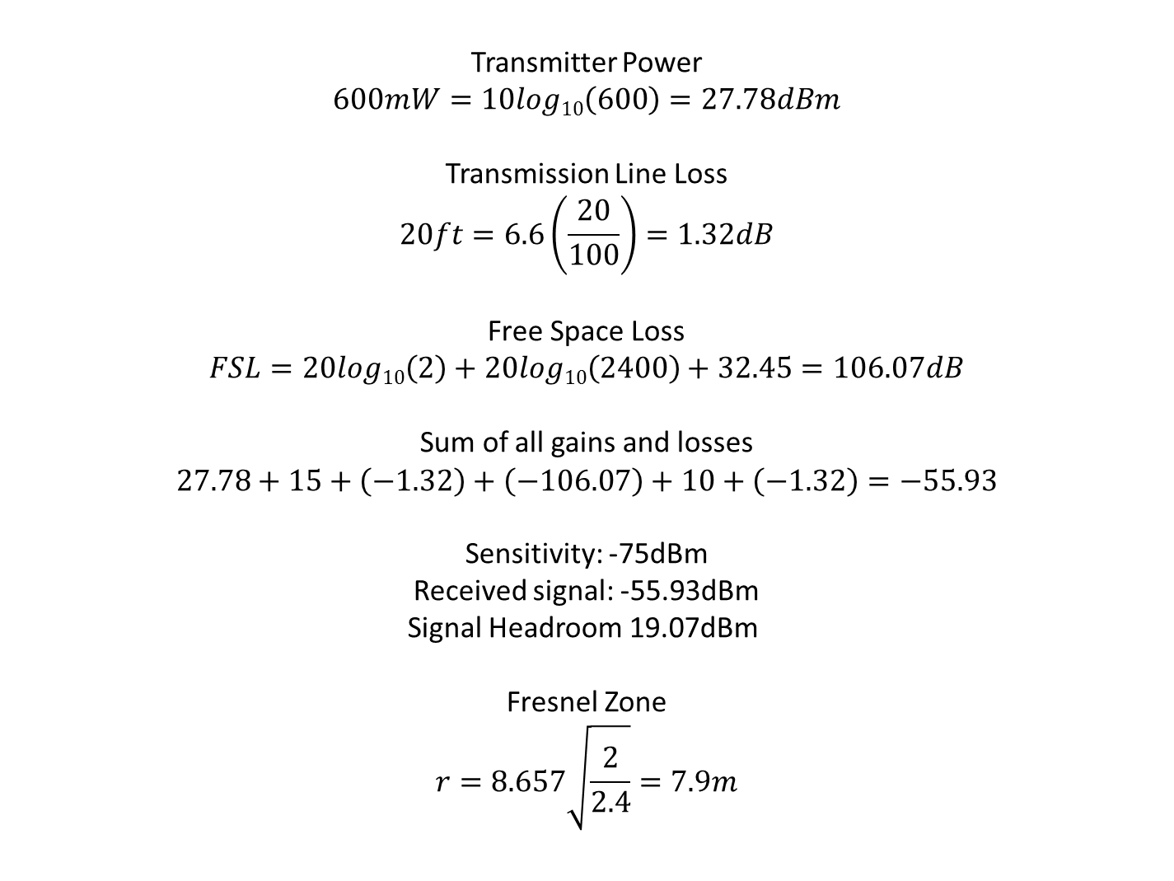
Transmitter Power
$$600mW=10log10\left(600\right)=27.78dBm$$
Transmission Line Loss
$$20ft=6.6\left(\frac{20}{100}\right)=1.32dB$$
Free Space Loss
$$FSL=20log10\left(2\right)+20log10\left(2400\right)+32.45=106.07dB$$
Sum of all gains and losses
$$27.78+15+\left(−1.32\right)+\left(−106.07\right)+10+\left(−1.32\right)=−55.93$$
Sensitivity: -75dBm
Received signal: -55.93dBm
Signal Headroom 19.07dBm
Fresnel Zone
$$r=8.657\sqrt{\frac{2}{2.4}}=7.9m$$

Slide 22
5GHz Specific Technologies
DFS – Dynamic Frequency Selection is the ability for a transmitter to dynamically change the output frequency in order to avoid interference with other stations
TPC – Transmitter Power Control is the ability for the transmitter to reduce power by up to 6dB in order to reduce interference to other nearby stations.

Slide 23
5GHz Operation
The radio spectrum between 5.150GHz – 5.850GHz is widely used for commercial and government purposes such as radionavigation, Earth satellite imaging, weather radar, militar radar, and satellite communication.
Surprisingly even with all this commercial use, unlicensed use is being permitted, and regulations are evolving to continue to allow unlicensed use on the 5GHz band.
Use of the 5GHz band comes with more responsibility though as interference on this band can disrupt critical commercial and military operation.

Slide 24
Regulations

Slide 25
Radio Regulations in Canada
Radio communication and licensing is handled by Industry Canada.
Relevant I.C. Documents:
RSS-Gen - General radio regulations
RSS-210 - License exempt radio regulations
RSS-247 - DTS, FHS, and LE-LAN regulations
FCC regulations are not applicable. Most online resources will cite FCC regulations which are not relevant to transmitters in Canada.

Slide 26
Regulations for 2.4GHz Transmitters
Under RSS-247 no distinction is made between DTSs (Digital Transmission Systems) and LE-LANs (License Exempt LANs). The regulations for DTSs are the relevant rules for 2.4GHz LE-LAN devices.
The only significant regulation for 2.4GHz transmitters is that transmitter power may not exceed 1W and EIRP may not exceed 4W.
An exception to this rule is point to point systems which may exceed 4W EIRP by means of a higher gain antenna, but are still limited to 1W transmitter output. There is no specified maximum EIRP for point to point systems.

Slide 27
Regulations for 5GHz Transmitters
The 5GHz spectrum is split into 5 separate sections with different rules applying to the different sections.
5150-5250MHz – Indoor use only
5250-5350MHz – Power restricted
5470-5600MHz – Frequency restrictions
5650-5725MHz – Frequency restrictions
5725-5850MHz – Standard restrictions

Slide 28
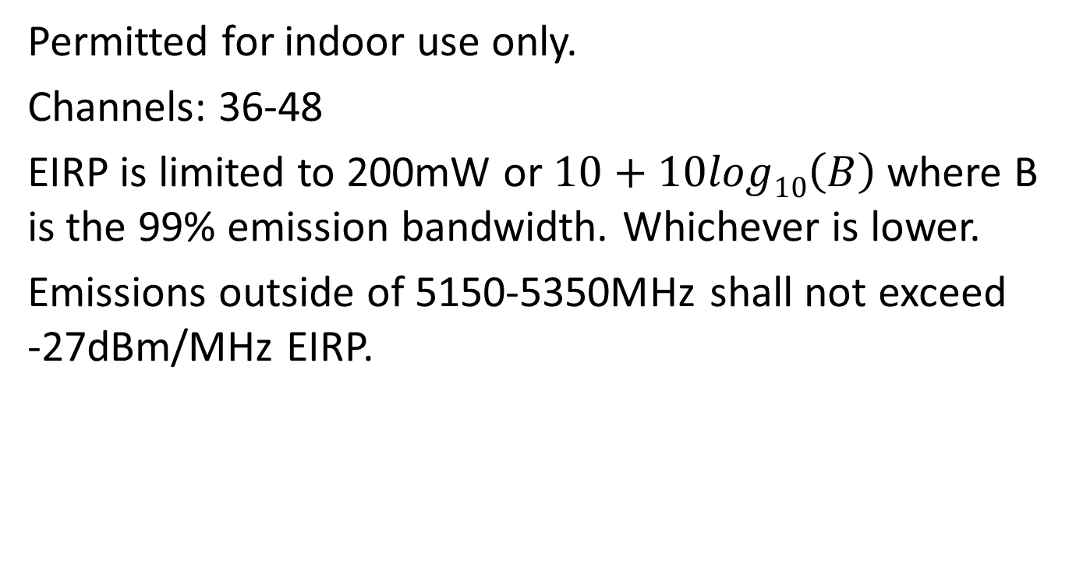
5150-5250MHz
Permitted for indoor use only.
Channels: 36-48
EIRP is limited to 200mW or $10+10log10\left(B\right)$ where B is the 99% emission bandwidth. Whichever is lower.
Emissions outside of 5150-5350MHz shall not exceed -27dBm/MHz EIRP.

Slide 29
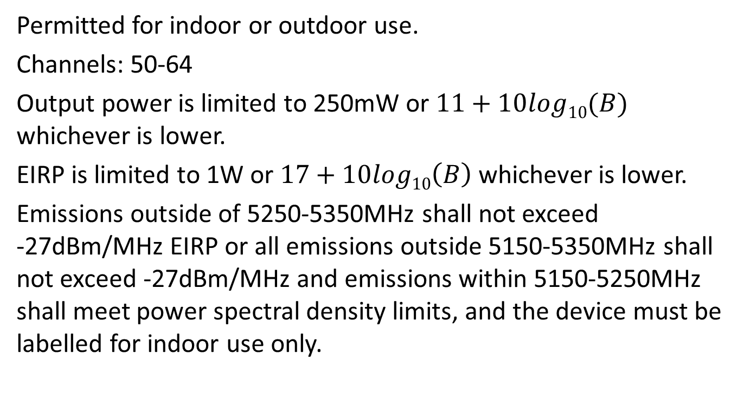
5250-5350MHz
Permitted for indoor or outdoor use.
Channels: 50-64
Output power is limited to 250mW or $11+10log10(B)$ whichever is lower.
EIRP is limited to 1W or $17+10log10\left(B\right)$ whichever is lower.
Emissions outside of 5250-5350MHz shall not exceed -27dBm/MHz EIRP or all emissions outside 5150-5350MHz shall not exceed -27dBm/MHz and emissions within 5150-5250MHz shall meet power spectral density limits, and the device must be labelled for indoor use only.

Slide 30
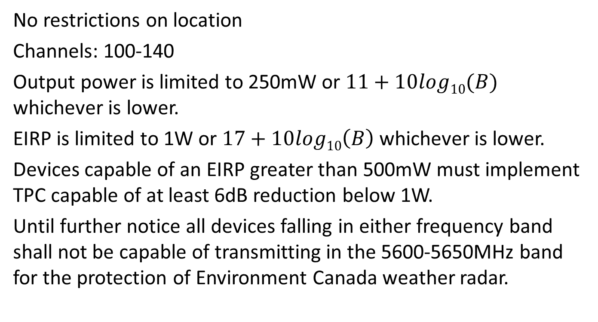
5470-5600MHz & 5650-5725MHz
No restrictions on location
Channels: 100-140
Output power is limited to 250mW or $11+10log10(B)$ whichever is lower.
EIRP is limited to 1W or $17+10log10\left(B\right)$ whichever is lower.
Devices capable of an EIRP greater than 500mW must implement TPC capable of at least 6dB reduction below 1W.
Until further notice all devices falling in either frequency band shall not be capable of transmitting in the 5600-5650MHz band for the protection of Environment Canada weather radar.

Slide 31
5725-5850MHz
No restrictions on location
Channels: 142-165
Output power is limited to 1W. If an antenna with more than 6dBi of gain is used output power and spectral density must be decreased by the amount in dB that the antenna exceeds 6dBi.
Fixed point to point systems may employ an antenna gain of more than 6dBi without a reduction in power.
Emissions within 10MHz of the band edges may not exceed -17dBm/MHz
Emissions beyond 10MHz of the band edges may not exceed
-27dBm/MHz

Slide 32
Dynamic Frequency Selection
Devices operating in the 5250-5350MHz, 5470-5600MHz, and 5650-5725MHz must be capable of DFS for the purpose of radar avoidance with the following requirements:
For EIRP < 200mW the detection threshold is -62dBm
For output < 200mW and EIRP < 1W the threshold is -64dBm
Devices must continually monitor for radar signals between normal transmissions.
The device must see that a channel is clear for at least 60 seconds before beginning transmission.
If a radar signal is detected all transmissions on that channel must stop within 10 seconds.
A channel will not be operated on for at least 30 minutes after a radar signal was detected.

Slide 33
Questions

